Slide 1

Session 5
Linear Programming – Transportation
Big Data and Analytics
Topic 5:
Data Exploration and Cleaning
We will wait for 5 to 10 mins for everyone to join

Slide 2

Recap
Linear Programming – Transportation
What we discussed last week?

Slide 3
Recap: Apache Spark
Linear Programming – Transportation
Apache Spark:
Apache Spark is a fast, in-memory data processing engine with elegant and expressive development APIs which enable data workers to efficiently execute streaming, machine learning, or SQL workloads.
why many organisations and individuals choose to use Apache Spark:
Performance: In-memory Computing, Optimised Execution Plans
Flexibility: Multiple Languages, Varied Data Sources
Unified Platform
Fault Tolerance
Scalability
Community and Ecosystem
Advanced Analytics
Stream and Batch Processing in One Framework
Ease of Use
Integration with Big Data Tools
Dynamic and Growing Ecosystem
Notes:
Performance:
In-memory Computing: Spark utilizes in-memory processing, which means it stores data in RAM instead of relying on disk-based storage. This leads to faster data access and computation speeds.
Optimized Execution Plans: With Catalyst optimizer, Spark creates efficient execution plans for operations, further speeding up tasks.
Flexibility:
Multiple Languages: Spark provides native APIs in Java, Scala, Python, and R. This broadens its appeal to developers from different programming backgrounds.
Varied Data Sources: It supports various data sources including HDFS, Cassandra, HBase, Amazon S3, and many more.
Unified Platform:
Spark offers built-in libraries for various tasks. This includes Spark SQL for SQL and structured data processing, MLlib for machine learning, GraphX for graph processing, and Spark Streaming for real-time data processing. This unification means that developers can use a single framework to handle varied processing tasks, simplifying the development process.
Fault Tolerance:
Through the lineage information of RDDs (and other data structures), if any partition of an RDD is lost, Spark can recompute it using its lineage. This ensures that data is not lost and computations can still proceed in the case of node failures.
Scalability:
Spark can scale from a single machine to thousands of nodes, making it suitable for tasks ranging from local data processing on a laptop to processing petabytes of data on a large cluster.
Community and Ecosystem:
Spark has a vibrant and active community. This means extensive documentation, regular updates, and a plethora of resources for new users.
Advanced Analytics:
Apart from basic data processing, Spark offers built-in libraries for more advanced analytics tasks. This includes machine learning (with MLlib) and graph algorithms (with GraphX).
Stream and Batch Processing in One Framework:
Unlike many other systems, Spark offers both batch processing and real-time stream processing in the same framework. This means you can use the same code base for both batch and stream processing tasks, simplifying development and maintenance.
Ease of Use:
High-level APIs and rich built-in functions make it easier to process data without getting into the intricacies of distributed computing.
Integration with Big Data Tools:
Spark integrates well with popular big data frameworks like Hadoop. For instance, it can use HDFS for distributed storage and run on YARN, the resource manager of Hadoop.
Dynamic and Growing Ecosystem:
Spark continues to evolve with contributions from a large community, making it a dynamic platform with continuous improvements and additions.
Considering these advantages, Apache Spark is often the tool of choice for big data processing, especially for organizations that require fast processing, ease of use, and the flexibility to handle diverse big data tasks with a unified platform. However, as with any technology, it's crucial to evaluate if Spark aligns with the specific requirements and infrastructure of the project at hand.

Slide 4
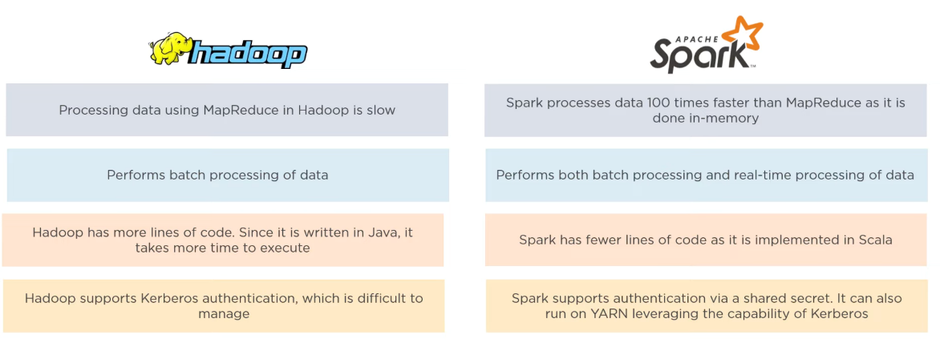
Recap: Comparison between Hadoop and Spark
Linear Programming – Transportation
Notes:
From What Is Apache Spark? | Apache Spark Tutorial | Apache Spark For Beginners | Simplilearn - YouTube

Slide 5
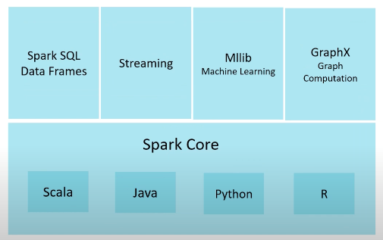
Recap: Apache Spark
Linear Programming – Transportation
Key Concepts:
Resilient Distributed Dataset (RDD): RDD is the fundamental data structure of Spark. It is an immutable distributed collection of objects that can be processed in parallel.
DataFrame & Dataset: These are higher-level abstractions over RDDs, introduced in Spark to support Spark SQL and structured data processing. They provide a more expressive and SQL-like API compared to RDDs.
Lazy Evaluation: One of the defining features of Spark. Computations are only executed when an action (like counting or saving to a file) is called, not when transformations (like map or filter) are defined. This allows Spark to optimize the execution plan.
Core Components:
Spark Core: Contains the basic functionality of Spark, including components for task scheduling, memory management, and fault recovery.
Spark SQL: Provides a programming interface for data structured as rows and columns (akin to a table in a relational database). It allows querying data via SQL as well as the Spark API.
Spark Streaming: Enables processing and analysing live data streams in real-time. Data can be ingested from various sources like Kafka, Flume, and more.
Spark MLlib: A distributed machine learning library with various algorithms for classification, regression, clustering, etc.
Spark GraphX: For graph computation, allowing processing of graph data structures and computation of standard graph algorithms.
Notes:
RDDs can be created from data stored in external storage systems or by transforming other RDDs.

Slide 6
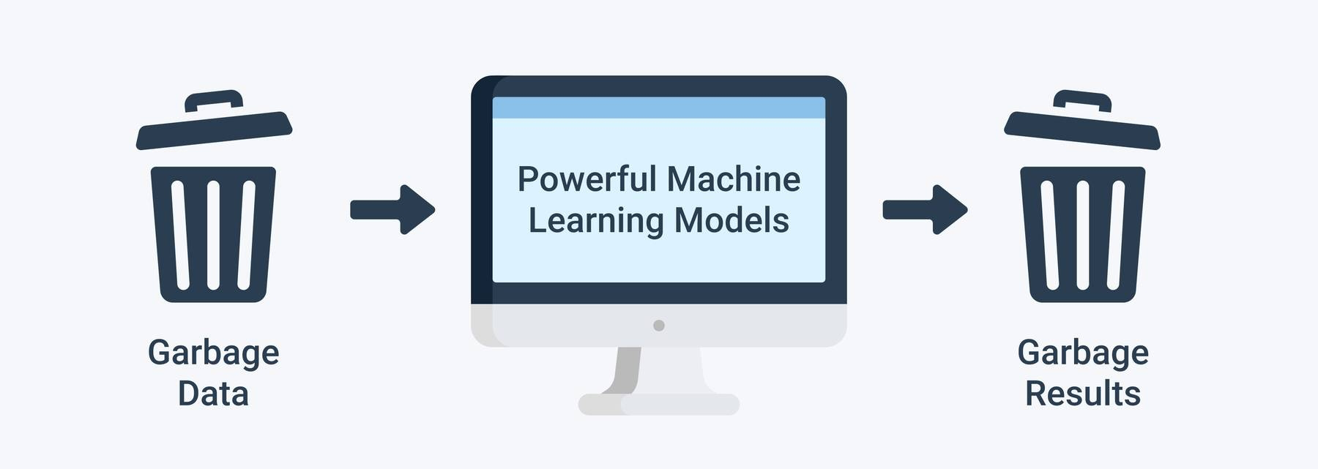
Data Exploration and Cleaning
Garbage in, Garbage out
Notes:
All decisions are based on data, if you don’t clean and prepare the data, the decisions will be based on something which is not right.

Slide 7
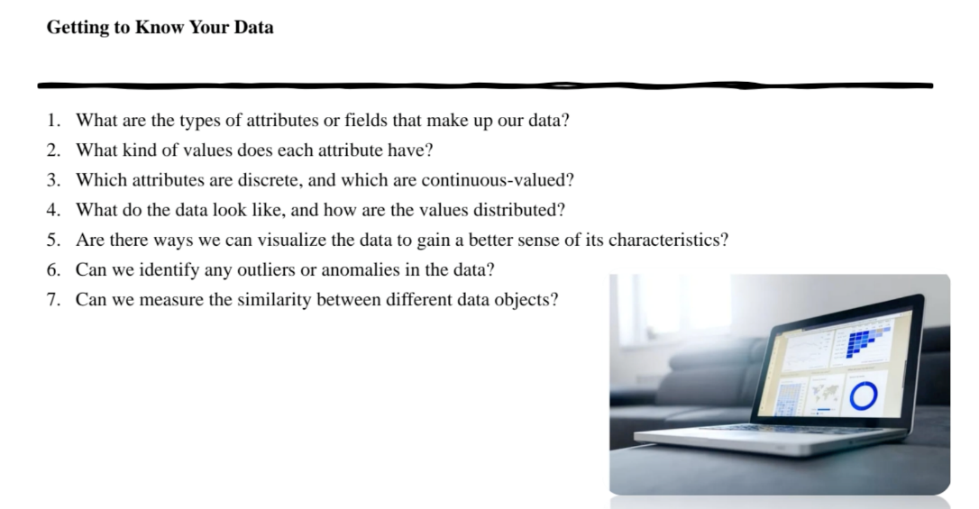
Data Exploration and Cleaning

Slide 8

Data Exploration and Cleaning
An attribute is a data field, representing a characteristic or feature of a data object.
Attributes describing a customer object can include, for example, customer ID, name, and address
The type of an attribute is determined by the set of possible values—nominal, binary, ordinal, or numeric
Nominal Data: also known as categorical data, is data that can be divided into categories but cannot be ordered or measured.
No inherent rank or sequence.
Example: Colours of a t-shirt: Red, Blue, Green, Yellow.
Binary Data: Binary data has only two possible values or categories. It's a special case of nominal data. Often, it represents outcomes like "Yes or No", "True or False", "1 or 0".
Example: Pass or Fail
Notes:
The categories can be labelled and identified, but there is no inherent rank or sequence among them.
Here, you can't say Red > Blue or Green < Yellow because they are simply categories with no relative ranking between them.
Pass or Fail in an examination. If a student passes, you mark it as "Pass", and if they don't, you mark it as "Fail". There are only two possible outcomes.

Slide 9
Data Exploration and Cleaning
Ordinal Data: represents categories with a specific order or ranking among them. While we can determine the order, the exact difference between categories is not specified or consistent.
Example: Rating a movie: Poor, Average, Good, Excellent. grade (e.g., HD, D, C, P, F and so on)
Numeric Data: represents quantifiable information that can be measured. It's further divided into two types:
Interval data which have consistent intervals between values but no true zero point (e.g., temperature in Celsius: 0°C does not mean absence of temperature).
Ratio data which have a consistent interval and a true zero point (e.g., height in centimetres: 0 cm means no height).
Example: Age of a person: 25 years.
Notes:
Here, "Average" is better than "Poor" and "Good" is better than "Average", but we don't know by how much exactly. The difference between "Poor" and "Average" might not be the same as the difference between "Good" and "Excellent".
This data can be measured, ordered, and has meaningful differences between values. If one person is 25 years old and another is 30 years old, the second person is exactly 5 years older than the first.

Slide 10
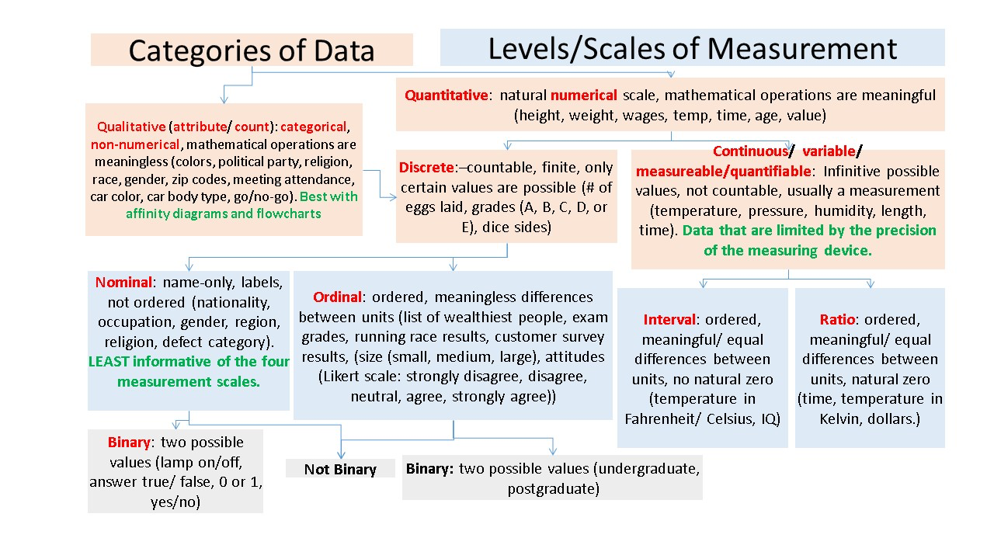
Data Exploration and Cleaning
Nominal
Binary
Ordinal
Numeric
Notes:
source of picture:https://stats.stackexchange.com/questions/159902/is-nominal-ordinal-binary-for-quantitative-data-qualitative-data-or-both

Slide 11

Data Exploration and Cleaning
Nominal attributes have values that represent different categories or labels (e.g., colours, types of fruits).
Binary attributes typically have values like 0 and 1, True and False, or Yes and No.
Ordinal attributes have values that can be ranked or ordered (e.g., low, medium, high).
Interval attributes have numeric values with consistent differences between them but no true zero (e.g., temperature in Celsius).
Ratio attributes have numeric values with a consistent interval and a true zero point (e.g., height, weight).

Slide 12
Data Exploration and Cleaning
Discrete attributes have distinct, separate values. Examples include the number of cars a person owns or the number of students in a class.
Continuous attributes can take on an infinite number of values within a range. Examples include height, weight, and age.

Slide 13
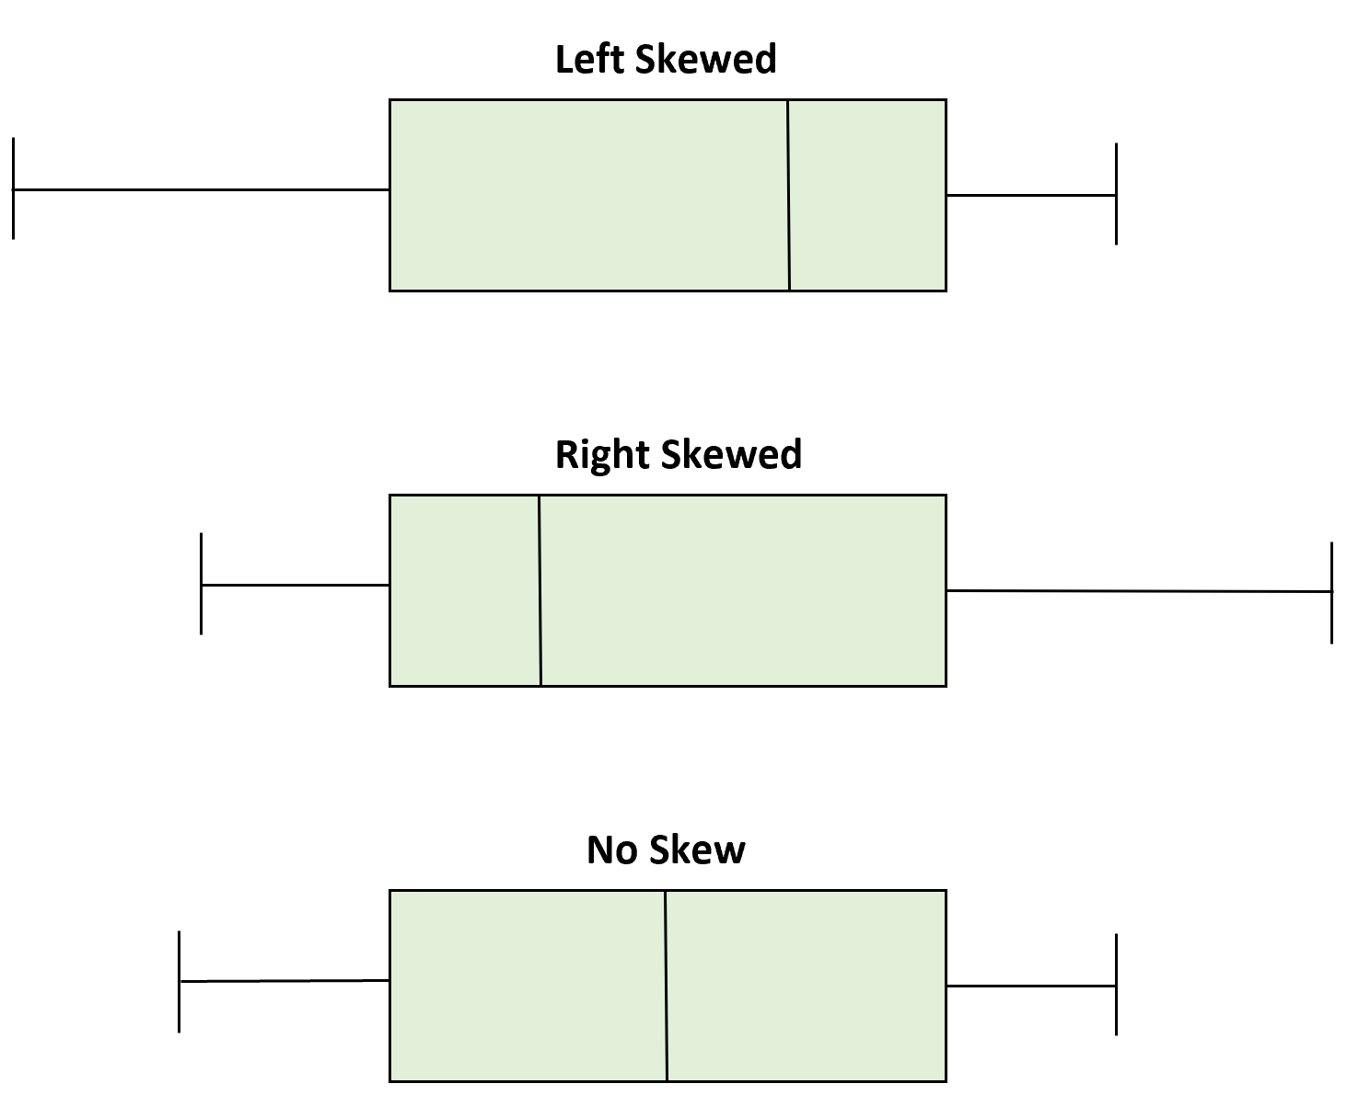
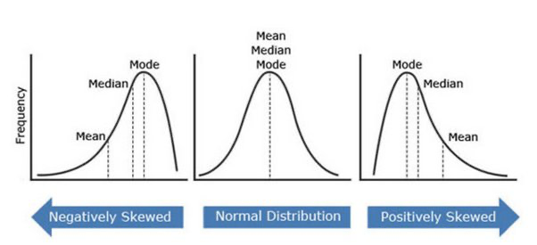
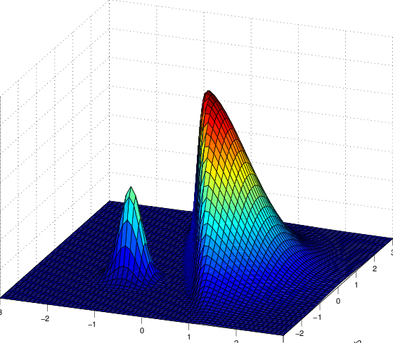
Data Exploration and Cleaning
This requires actual data visualization or statistical analysis.
Common tools include:
histograms,
box plots, or
density plots to understand distribution.
Some data might be:
normally distributed,
or skewed to the left or right.
Notes:
Normal Distribution (Bell Curve)
Example: Imagine a class where most students scored around 70 out of 100, with fewer students scoring very high (like 90+) or very low (like below 50). This data might be normally distributed.
Impact on Analysis:
The mean, median, and mode will be roughly the same, centered at the peak of the distribution.
Data analysis becomes more predictable. Standard statistical tests (like t-tests) that assume normality can be applied.
It's easier to make inferences about the population based on sample data.
Right-Skewed (Positive Skew) Distribution
Example: Now, imagine a difficult class test where most students scored between 10 to 50, but a few exceptionally good students scored above 90. This creates a long tail on the right side of the distribution.
Impact on Analysis:
The mean will be greater than the median, which is greater than the mode.
Standard measures like the mean can be misleading since they'll be pulled up by the few high scores.
Non-normality tests or data transformations may be necessary before applying certain statistical tests.
Left-Skewed (Negative Skew) Distribution
Example: Consider a very easy class test where most students scored between 60 to 100, but a few students who didn't study at all scored below 20. This creates a long tail on the left side of the distribution.
Impact on Analysis:
The mean will be less than the median, which is less than the mode.
Standard measures like the mean can be misleading since they'll be pulled down by the few low scores.
As with the right-skewed distribution, certain statistical tests might not be directly applicable, necessitating data transformations or non-parametric tests.

Slide 14
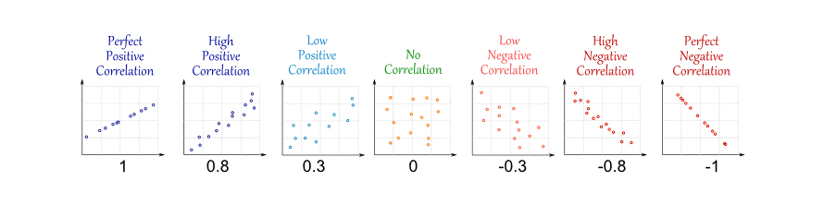
Data Exploration and Cleaning
Notes:
A scatter plot is one of the most effective graphical methods for determining if there appears to be a relationship, pattern, or trend between two numeric attributes

Slide 15
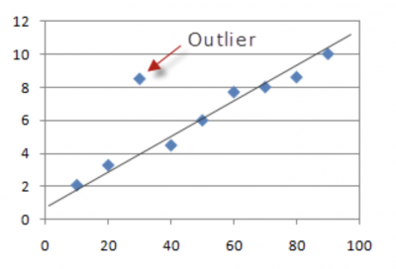
Data Exploration and Cleaning
Outliers or anomalies can often be identified using visual tools like box plots, where points outside the "whiskers" might be considered outliers.
Statistical methods like z-scores can be used to detect outliers.

Slide 16
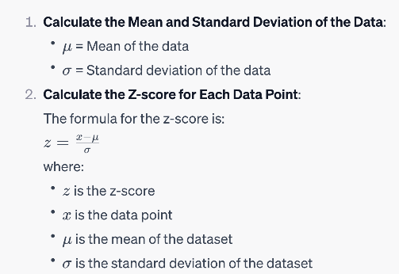
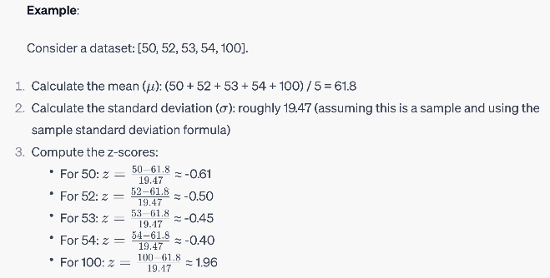
Data Exploration and Cleaning
Identifying outlier with z-score:

Slide 17
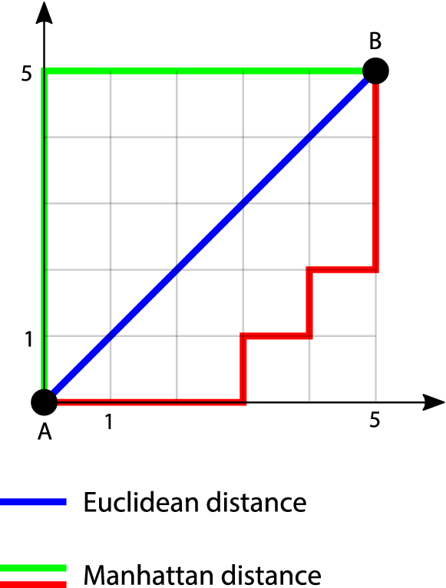
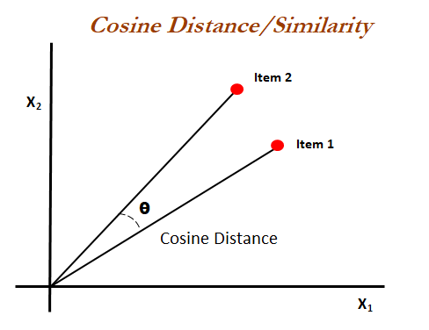
Data Exploration and Cleaning
There are various techniques to measure similarity or dissimilarity between data objects.
Common methods include:
The Euclidean distance,
Manhattan distance, and
cosine similarity for continuous data.
For categorical data, methods like:
the Jaccard coefficient or
Hamming distance might be used.

Slide 18
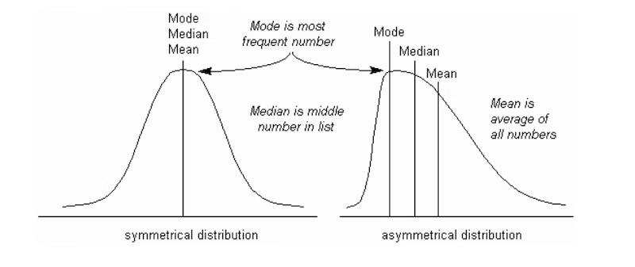
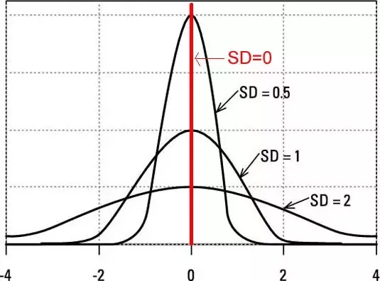
Data Exploration and Cleaning
Mean
Median
Standard Deviation
Notes:
mean vs median: the example of the monthly salaries (in thousands) of a small team of employees at a company

Slide 19
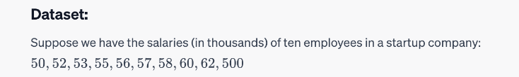
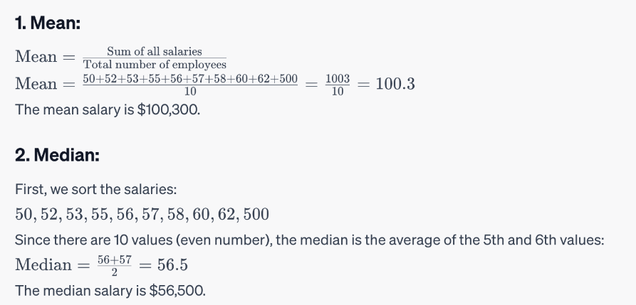
Data Exploration and Cleaning
Mean, Median, Standard Deviation

Slide 20
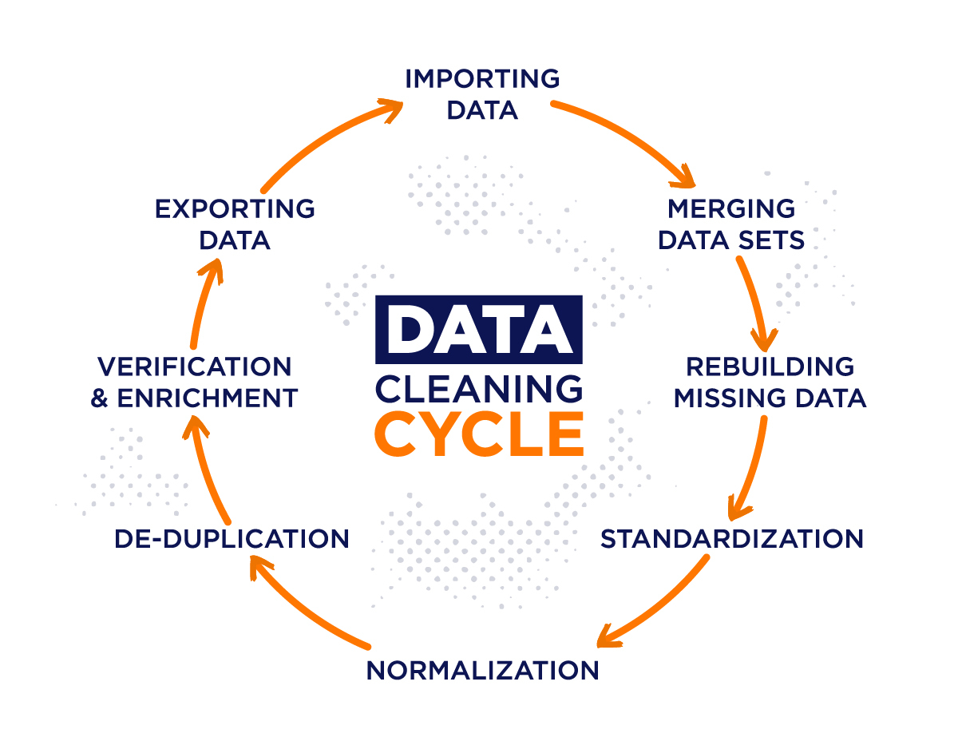
Data Exploration and Cleaning
Cleaning data involves a series of steps to detect and correct (or remove) errors and inconsistencies in data.
Notes:
Data cleaning routines work to “clean” the data by filling in missing values, smoothing noisy data, identifying or removing outliers, and resolving inconsistencies.

Slide 21
Data Exploration and Cleaning
Dealing with Missing Values
4. Model-based Techniques:
Multiple Imputation: It imputes missing data multiple times. Each imputation is a random sample from a distribution, making it possible to account for the uncertainty of missing values in statistical analyses.
Expectation-Maximization: An iterative method that seeks to maximize the likelihood function when there's missing data.
5. Stochastic Regression: Like regression imputation, but it adds a random error term.
6. Fill Methods for Time Series:
Forward Fill: Takes the previous value and fills the next missing value.
Backward Fill: Takes the next value and fills the previous missing value.
7. Using External Data: If possible, you can use external data sources to fill missing values. This requires having a reliable external source that aligns well with your data.
8. Impute Using Distribution: If you know the distribution of your data, you can sample from this distribution to impute missing values.
Deletion:
Listwise Deletion (Complete Case Analysis): Removing any row with at least one missing value. This is straightforward but can lead to a significant reduction in sample size.
Pairwise Deletion: Used in statistical analyses when data points are missing at random. This method calculates all analyses possible for each data point, maximizing the amount of data included.
Imputation:
Mean/Median/Mode Imputation: Replace missing values with the mean (for continuous data), median (when the data has outliers), or mode (for categorical data).
Last Observation Carried Forward (LOCF): In time-series data, a missing value is replaced by the last observed value.
Next Observation Carried Backward (NOCB): Opposite of LOCF, a missing value is replaced by the next observed value.
Linear Interpolation: In time-series data, values are imputed based on linear trends observed in existing data.
Predictive Techniques:
Regression Imputation: Use a regression model where the variable with missing values is treated as the dependent variable and other variables as predictors.
K-Nearest Neighbors (KNN) Imputation: For a data point with missing values, it identifies 'k' similar observations and imputes missing values based on them.
Machine Learning Models: Train models like Random Forest or Deep Learning networks to predict and impute missing values.
Notes:
Dealing with missing values is a crucial aspect of data cleaning, as missing values can introduce bias or reduce the statistical power of a dataset. Several techniques can be employed to handle them:

Slide 22
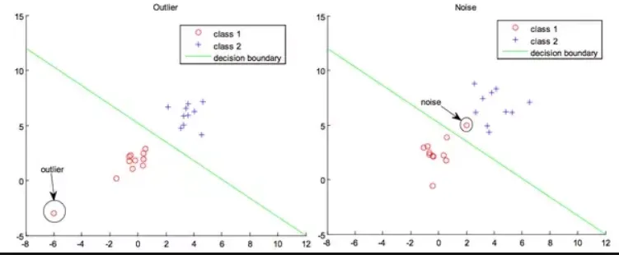
Data Exploration and Cleaning
Dealing with Noisy Data and Outliers
Notes:
“What is noise?” Noise is a random error or variance in a measured variable
Values that are more than two standard deviations away from the mean for a given attribute may be flagged as potential outliers

Slide 23
Data Exploration and Cleaning
Dealing with Noisy Data
Noise can be thought of as random errors or variances in a measured variable. Here are some methods to deal with noisy data during the data cleaning process:
6. Transformation:
Logarithmic, exponential, or other mathematical transformations can sometimes stabilize the variances and make the noise more manageable.
7. Clustering:
Group data into clusters and treat intra-cluster variations as noise. The centroid of a cluster can represent the group of data points.
8. Data Imputation:
Replace noisy data with values estimated from other related information. Techniques include mean imputation, k-nearest neighbours, or more advanced techniques like multiple imputations.
9. Decomposition:
Especially for time-series data, techniques like Seasonal Decomposition of Time Series (STL) can help in separating the trend, seasonality, and residuals. The noise often resides in the residual component, which can be treated separately.
10. Robust Methods:
Use algorithms or statistical measures that are less sensitive to outliers or high variances, such as robust regression or rank-based methods.
Filtering:
Low-pass filters: Useful for time-series data. They allow slow-changing signals to pass through while blocking rapid changes.
Median filters: Replace each data point with the median of neighbouring data points. It's effective in removing salt-and-pepper noise(random bright or dark pixels) in images.
Smoothing:
Moving average: Calculates the average of the surrounding data points to smooth out short-term fluctuations.
Exponential smoothing: Gives more weight to recent observations and can be used for time-series data.
Binning:
Grouping a set of continuous data points into bins and then replacing the data points with a central tendency measure (e.g., bin mean or bin median). This can smoothen out minor errors or variations.
Regression:
Fit the data to a regression function (linear, polynomial, etc.) and then use the function to predict and replace noisy values.
Outlier Detection:
Techniques like Tukey's fences, IQR (Interquartile Range), Z-scores, or visualization methods (box plots, scatter plots) can help identify outliers which may be considered as noise.
Advanced methods include clustering algorithms (like DBSCAN) or anomaly detection methods to identify unusual data points.

Slide 24
Data Exploration and Cleaning
Dealing with Outliers
Outliers can unduly influence the results in unpredictable ways. Here are methods to detect and handle outliers:
Visualization:
Box Plots: Display the overall distribution of the data, where outliers can be identified as points outside the "whiskers".
Scatter Plots: In multidimensional data, scatter plots can help visualize anomalous data points.
Histograms: View the frequency distribution of a continuous variable and spot any bars that stand apart from others.
Statistical Tests:
Z-Score: Represents the number of standard deviations a data point is from the mean. A high absolute value of the Z-score can indicate an outlier.
IQR (Interquartile Range): Anything outside the range (Q1 - 1.5IQR) to (Q3 + 1.5IQR) can be considered an outlier.
Distance-based Methods:
Mahalanobis Distance: Measures distance from a point to a distribution. Points with a large distance might be outliers.
Euclidean Distance: In clustering algorithms like k-means, the distance of points from cluster centroids can help identify outliers.
Density-based Methods:
DBSCAN (Density-Based Spatial Clustering of Applications with Noise): Clusters data into dense regions. Points that don't belong to any cluster can be treated as outliers.
5. Model-based Methods:
One-Class SVM: Used for anomaly detection. It distinguishes between normal data and outliers.
Isolation Forest: Randomly selects a feature and splits data, isolating outliers in the process.
6. Clustering:
Algorithms like k-means can be used to cluster data. Data points that do not belong to any cluster or are far from cluster centroids might be outliers.
7. Residual Analysis:
In regression models, examining residuals (difference between observed and predicted values) can help identify outliers.
8. Robust Statistical Measures:
Use median and MAD (Median Absolute Deviation) instead of mean and standard deviation, as they are less sensitive to extreme values.
9. Domain Knowledge:
Often, domain expertise can provide insight into what constitutes an outlier. For instance, in medical data, readings beyond physiological limits might be considered outliers.
10. Capping & Flooring:
Instead of removing outliers, they can be capped (upper limit) or floored (lower limit) to a certain value based on domain-specific decisions.
Notes:
Dealing with missing values is a crucial aspect of data cleaning, as missing values can introduce bias or reduce the statistical power of a dataset. Several techniques can be employed to handle them:

Slide 25
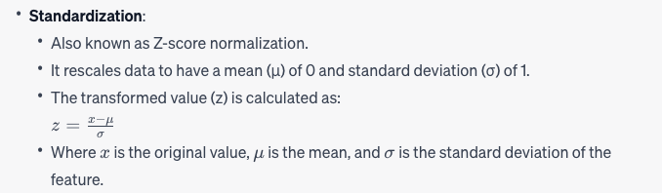
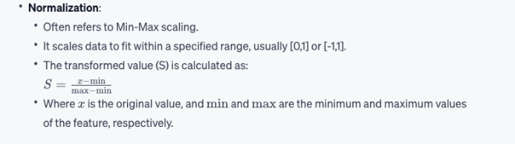
Data Exploration and Cleaning
Standardising VS Normalisation
Both standardization and normalization are techniques used to scale and transform data, making it more suitable for analysis and various machine learning algorithms. However, they serve different purposes and involve different techniques.
Notes:
Dealing with missing values is a crucial aspect of data cleaning, as missing values can introduce bias or reduce the statistical power of a dataset. Several techniques can be employed to handle them:

Slide 26
Data Exploration and Cleaning
Dealing with duplicated data
Duplicate data can introduce bias, skew results, and lead to incorrect conclusions. Here are methods to identify and handle duplications during data cleaning:
Row-wise Duplicate Check:
Look for and remove rows that have the exact same values across all columns.
Subset Duplicate Check:
Sometimes only a subset of columns needs to be unique. Check for duplicates based on this subset.
Use of Unique Identifiers:
If your data has a unique identifier (e.g., user ID, transaction ID), use it to quickly detect and eliminate duplicates.
Timestamp Analysis:
If there are timestamps associated with the data, they can help distinguish between legitimate repeated entries and actual duplicates.
Fuzzy Duplicate Detection:
For cases where entries might be slightly different due to typos or formatting differences, use fuzzy string matching algorithms (like Levenshtein distance) to detect duplicates.
6. Data Deduplication Software:
There are specialized software and tools that focus on deduplicating data, especially useful for large datasets or complex deduplication scenarios.
7. Consistency Checks:
Cross-reference related columns to spot inconsistencies. For example, if two rows have the same email but different names, they could be duplicates or indicate data entry errors.
8. Hash Functions:
Convert rows or subsets of data into a hash code. Identical data will have the same hash, making duplicates easier to spot, especially in large datasets.
9. Sorting Data:
Sorting the data by different columns can make duplicates more apparent, especially in visual inspections.
10 Visual Inspection:
For smaller datasets, a straightforward visual inspection can be effective. However, this method doesn't scale well for large datasets.
Notes:
Dealing with missing values is a crucial aspect of data cleaning, as missing values can introduce bias or reduce the statistical power of a dataset. Several techniques can be employed to handle them:
Bias results: e.g., if one customer’s data appears twice, they get “counted twice.”
Skew statistics: averages, totals, or frequencies become inaccurate.
Mislead models: machine learning algorithms may think repeated data is more important than it really is.
Waste storage and processing time.

Slide 27
Break
Linear Programming – Transportation
break (10 mins)
Set Up your Jupyter We will do some coding to explore a DataFrame with PySpark and Panda

Slide 28
Questions?

